Slide 1


Transformers
Daniel S do Nascimento
8.1 Capstone Project

Slide 2
How did this impact me?
Until two weeks ago I was hooked on GANz Nets. But when I looked at Transformers in a more serious way...

Slide 3
Why is this important to me?
I noticed that a lot of people publish templates, tutorials, but when checking, everyone goes to that point which is common. Working with texts, NLP is complex - given the moment, I think it's important to have mastery....

Slide 4
Besides…
I would like to create a classification architecture powered by Deep Learning… I believe Transformers is at the core of this architecture which will have another DNNs.

Slide 5
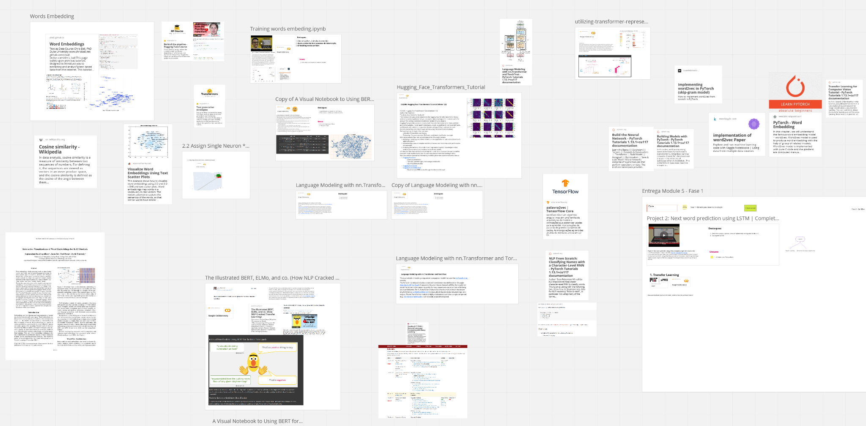
What I have?
Willpower and a bunch of material to research...

Slide 6
What I need?
Dig deep into transformer knowledge;
It means, not only transformers, but go deeper in pytorch models
Study more the training process, fine tuning;
Map complexity related to Portuguese dictionary;
Create a web interface to interact with the various transformers.

Slide 7

Notebook Google Colab
I wanted to do a more elaborate project, but without having at least a minimal domain, I don't think it's cool to move forward.

Slide 8
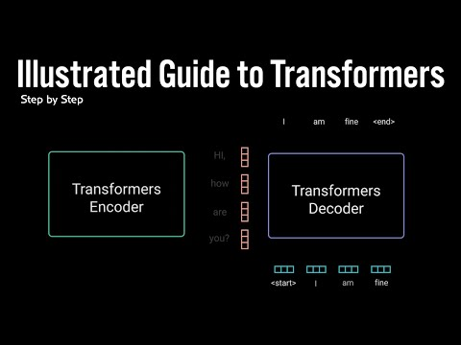
This video help me a lot
But I want to go deeper. I'm really willing to invest a lot of time to understand this architecture in detail

Slide 9
Milestones
Deepen in theory, abstracts, etc.
NLP Models
practical learning
Portuguese dictionary
fev/23 |  |  |  | Mar/23 |  |  |  |  |  |  |  | Apr/23
My DEV environment will be fully operational
simpler models with a user interface

Slide 10
Thank you very much

